Slide 1
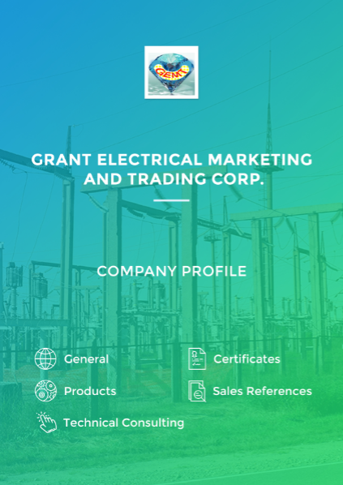

Slide 2
Greetings!
Having over 35 years experience in Korea Electric Power Corporation (KEPCO) in distribution sector as an operation engineer, leader of overseas projects, director of manufacturer support team, and Head instructor at KEPCO Academy,
And serving one and half years for Department of Energy (DOE) and 3 years in National Electrification Administration (NEA) of the Philippines as a Consultant
GRANT ELECTRICAL MARKETING AND TRADING CORP. was established in the Philippines with Korean best quality manufacturers.
We promise to provide not only high quality materials certified and proven by KEPCO or Korea Government Agency at the competitive price, but also the well experienced consultancy service.
Also, we will contribute to the development of economy as well as improvement of electrical sector in the Philippines.
Engr. Sang Jin Sun
President
“Go together for the bright future, God be with us always!”

Slide 3
1. General
SEC NO: CS201623004
MAYOR’S PERMIT: 16-012104
BIR: 2303 (OCN: 3R0000765972)
TIN: 009-425-724-000
Capital: 10Million Pesos
Established: October 4th, 2016
Email: gemt16@gmail.com
Phone: 02 576 5690(TELEFAX), 0947 346 4009(S)
Website: www.grantrading.ph
Address: Unit 2E, Symphony Tower 1,
#6 Sgt. Esguerra Ave. South Triangle Brgy. Q.C.
Office Map
SM North
ABS-CBN
NEA
Q.C
Circle
Office
MRT GMA
Timog
Circle
CALTEX ☆
EDSA
Cubao

Slide 4
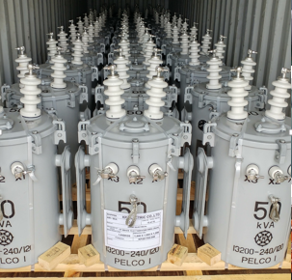
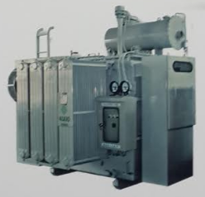
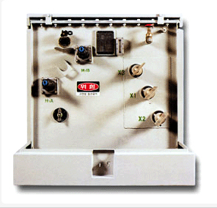
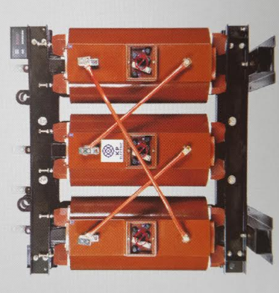
2. Products
Transformers
Pole Transformer
“KP Electric” Exclusive Distributor
Voltage Level: 13.2~34.5kV
Capacity: 5~333kVA
NEA standard
Silicon or Amorphous core,
Copper or Aluminum coil
Power Transformer (KP Electric)
Voltage Level: 69kV
Capacity: Up to 60MVA
Oil Type: Natural oil
Other Transformers
PAD Transformer
Oil Merged Transformer
Cast Resin Transformer
(Voltage Level: 13.2~34.5kV)
KP Electric was selected the best quality manufacturer by KEPCO in June, 2016.
KP Electric has supplied the highest number of DTR to KEPCO since 2013.

Slide 5
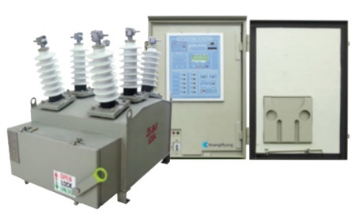
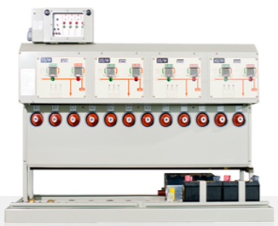
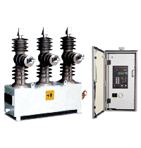
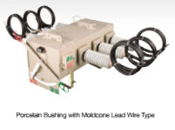
Breakers & Switches
Recloser
SF6 Gas Insulated, Vacuum Interruption Type
Solid type
Voltage Level: 13.2~35kV
Solid Type or SF6 Type Switches (PAD, LBS)
Dongyang ECC Corp. Exclusive Distributor
KEPCO Trust Partner
Korean Best Quality
Voltage Level: 13.2~35kV
사진
25kV level Breakers and Switches are recommended
- Price is not big different, More stable in the line
- For future voltage upgrading from 13.2kV to 23kV

Slide 6
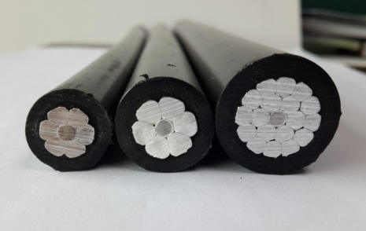
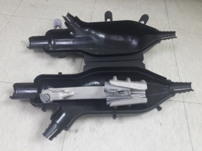
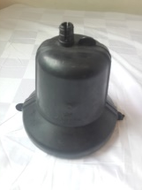
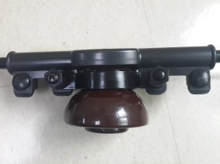
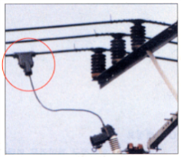
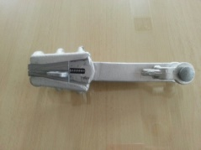
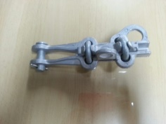
Insulated Wire System
Insulated Wire (Smooth Body Type)
ACSR/AW-OC , ACSR/AW-TR/OC
Voltage Level: 15~35kV
Improve reliability, Reduce system loss & Wind loading
Very much suitable for Philippines
KEWIC Marked Quality Guarantee
Seoul Electric Cable Distributor
Other wires ( For Transmission and Distribution)
Covers (Prevent Fault)
Deadend, DTR Bushing Cover
Bindless, Stir up Cover
Voltage Level: 35kV
Can be supplied quarterly base
Deadend Clamp (For insulated wire system)
1/0 ~ 336MCM
Can be supplied quarterly base
Stir up & clamp
1/0 ~ 336MCM
Can be supplied quarterly base
사진
Photo
Photo
For reliability and safety Improvement the insulated wire system with smooth body type wire is strongly recommended

Slide 7
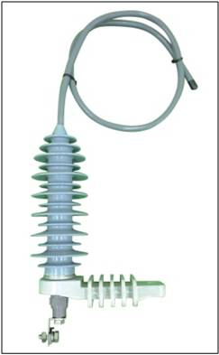
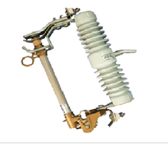
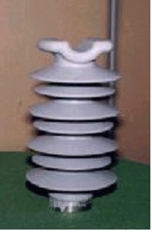
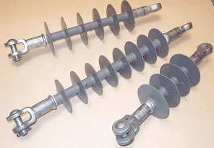
LA & Insulators
Lightening Arrester
Voltage Level: 11~18kV
Cut Out Switch (COS)
Voltage Level: 15~35kV
Polymer Insulator
Pin Type
Suspension Type
Voltage Level: 15~70kV
Photo
Photo

Slide 8
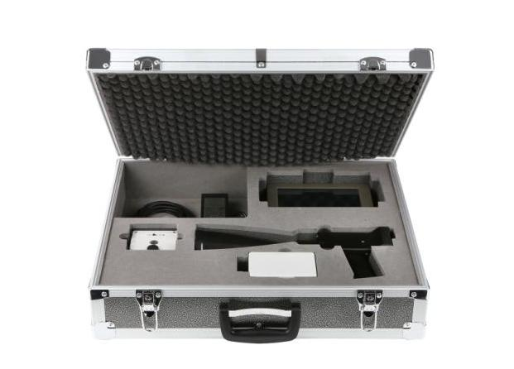
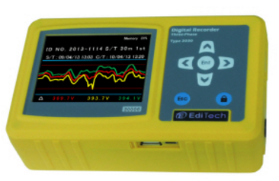
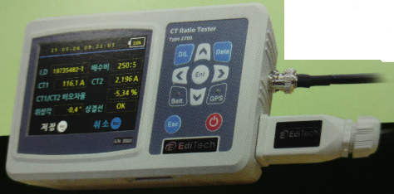
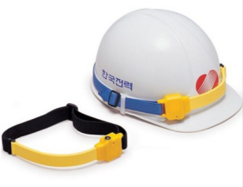
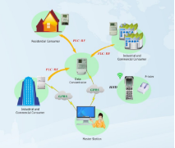
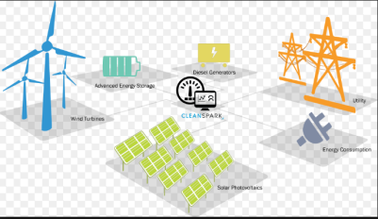
Detector & Others
Ultrasound Detector
Manufacturer: UDS (WIFI, GPS Tracking)
Prevent fault and reduce system loss
by detecting cracked insulators, loose
connection and leakage.
Thermal scanner can’t detect cracked insulator, but this one is possible.
Proven as the best quality by KEPCO
Exclusive Distributorship
Voltage Recorder
Voltage: 150~450V
1∮, 3∮
NEA, KEPCO Adapted
CT Error Tester
Live line tester
KEPCO Adapted
Safety Devices
LED COS Stick
Increase safety and work efficiency
Korea Government Patent
Exclusive distributorship
Live-line Alarm
KEPCO Adapted
AMI, DAS System, Micro Grid
Adapted in KEPCO
Modified for Philippines

Slide 9
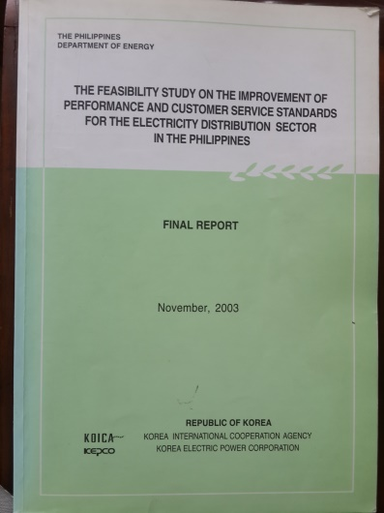
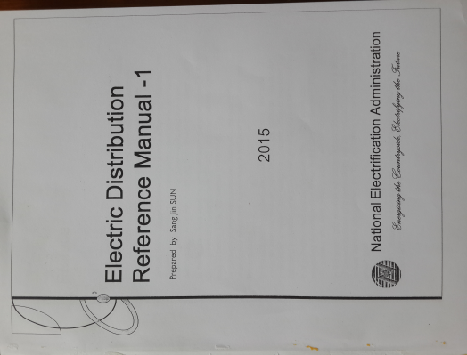
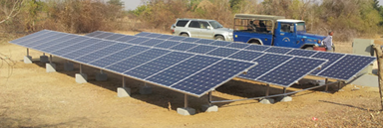
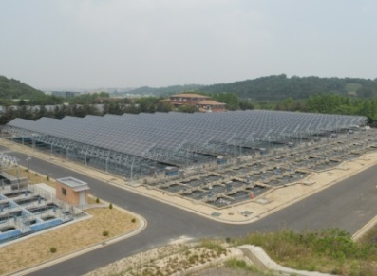
3. Technical Consulting
System Loss Reduction
System Diagnosis
Provide Solution
Provide Seminar
DOE Consulting Book
(Team Leader: Sang Jin Sun)
Reliability Improvement
System Diagnosis
Provide Solution
Provide Seminar
NEA Reference Manual
(Prepared by Sang Jin Sun)
Renewable Energy
Solar system
Hybrid system
Development/Design
Installation
Certified Professional Solar Engineer – Sang Jin Sun

Slide 10
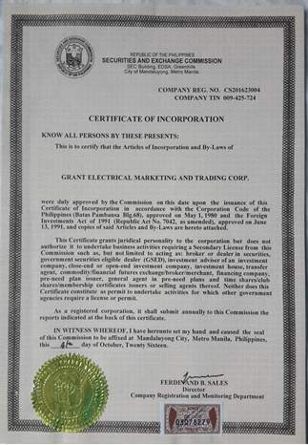
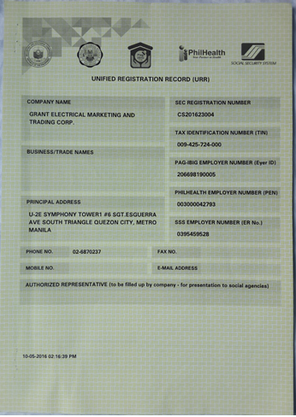
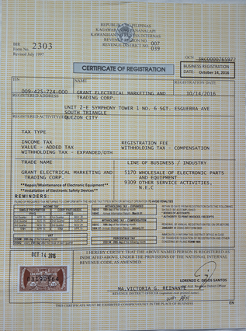
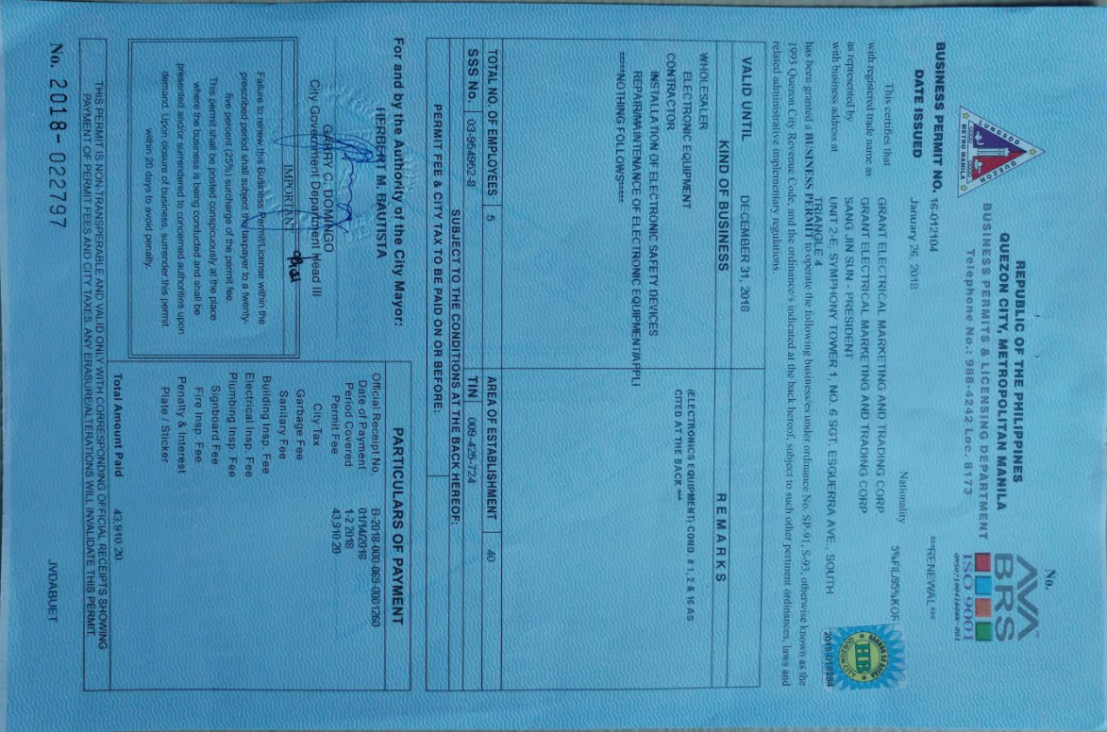
4. Certificates
A-1. SEC Registration -1 A-2. SEC Registration -2
B. Mayor’s Permit
C. COR from BIR

Slide 11
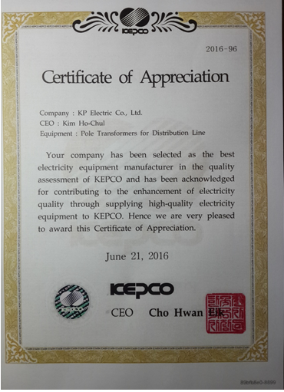
D. KEPCO Certificate (KP Electric is the best)

Slide 12
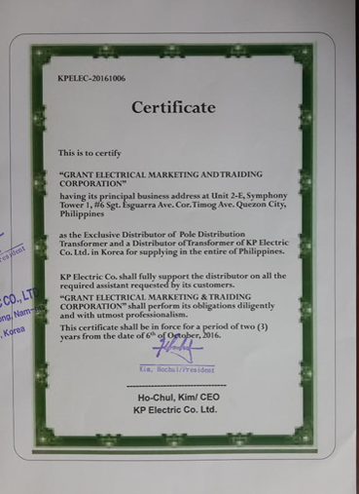
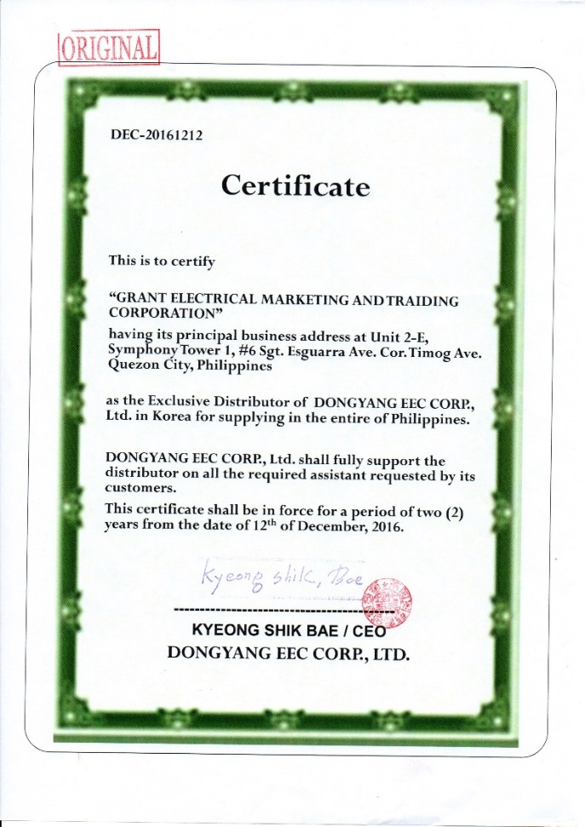
E. Certificate of Exclusive Distributorship
KP Electric :
- The Best Quality Manufacturer for Transformer selected by KEPCO
- KEPCO Trust Partner
DongYang EEC:
- KEPCO Trust partner.
- Expert in Switches

Slide 13
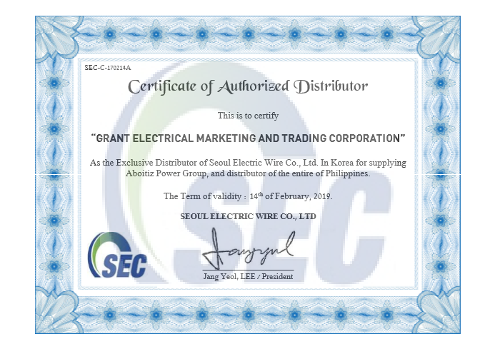
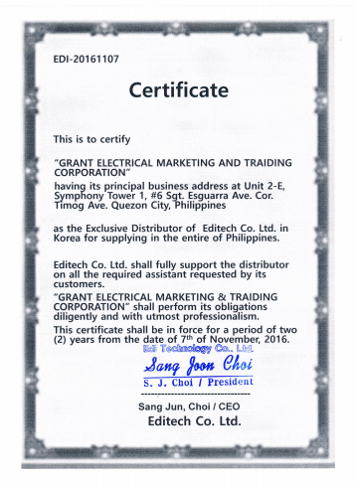
Editech - Geneva Invention Gold Medal Co.
Seoul Electric Cable
- KEWIC marked Quality Guarantee Co.
UDS Korea
WIFI, GPS Tracking Ultrasound Detector

Slide 14
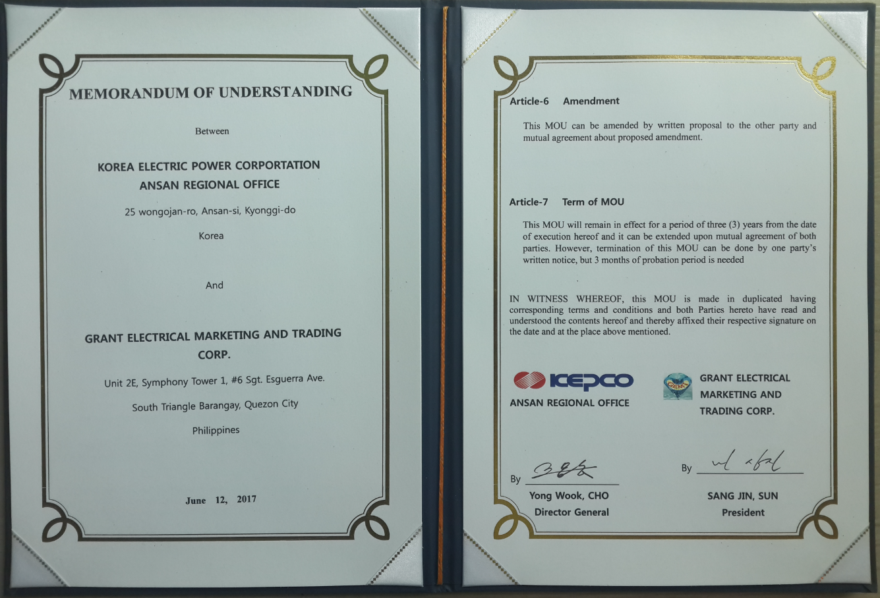
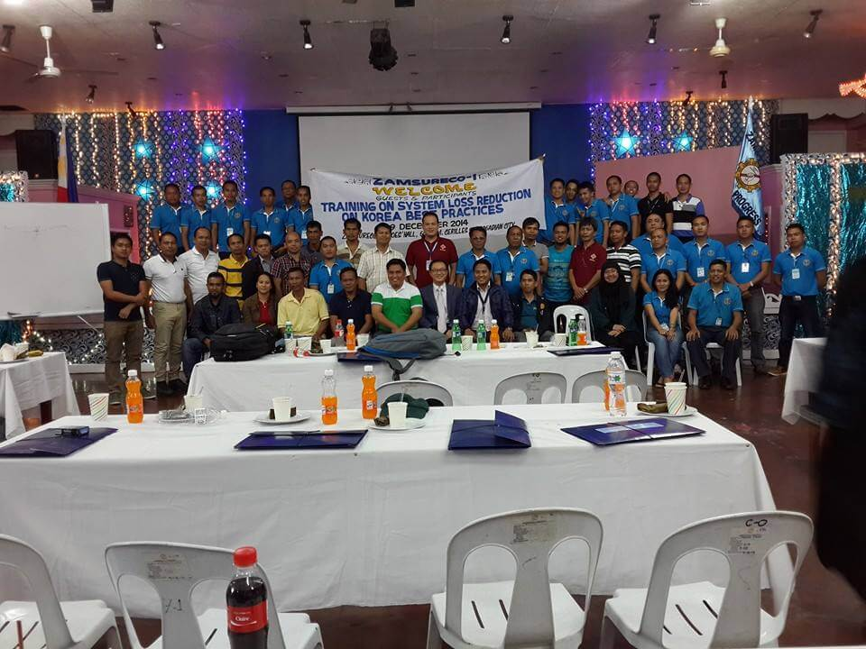
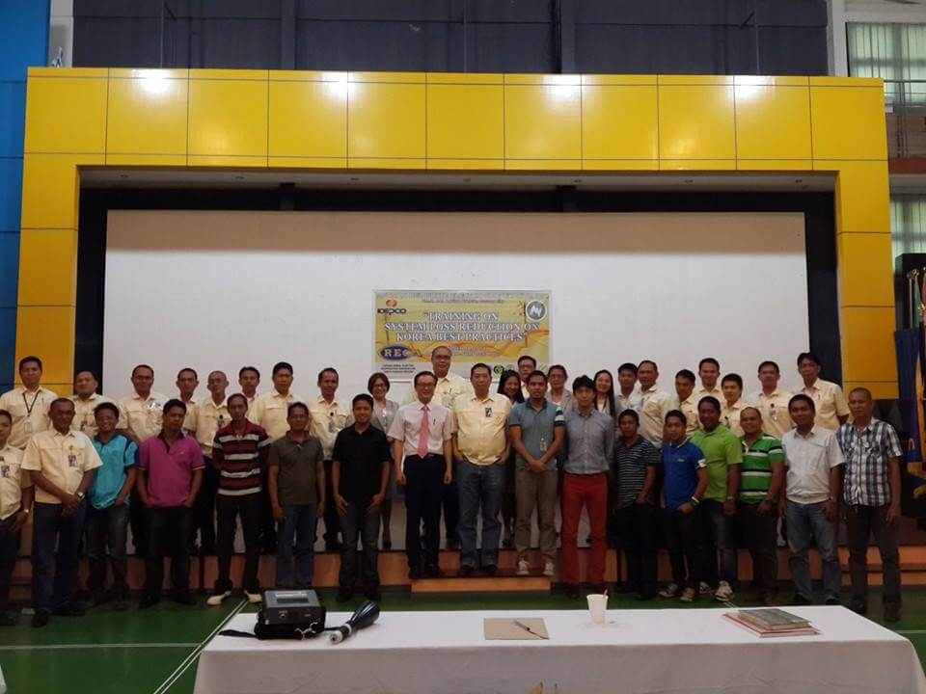
We are working with Korea Electric Power Corporation (KEPCO) to support Philippine Electrical Sector.

Slide 15
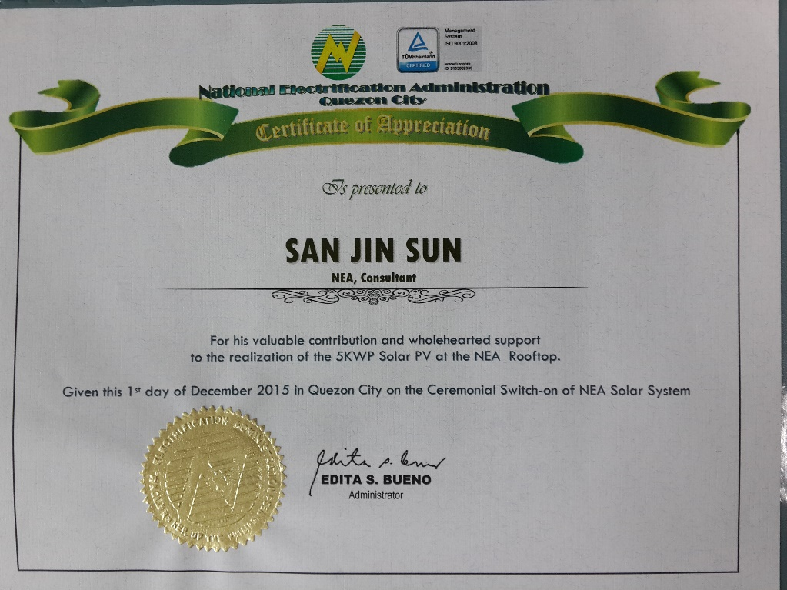
We want to work with NEA and ECs.

Slide 16
5. Sales References
A. KP Electric Transformer (over 500KVA For Philippines only)
DATE | ITEM | Remark
2011 | 10MVA*1, 500K*1, 6M*1, 750k*17, 3M*1, 1.5M*1, | Oil Type
2012 | 20M*1, 6M*1, 2M*2, 2.7M*1, 800K*1 | “
2013 | 25MVA,*1 3M*1, 33MVA*1 2M*1, 750k*1, 5M*3, 1M*1, | “ “
2014 | 25MVA*1, 2M*2, 1.5M*5, 1M*5, 12M*1, 750k*2, 5M*1,, 4M*1 | “
2015 | 50MVA*1, 25M*3, 2M*1, 20*1, 4M*1, | “
2016 | 15MVA*1, 1.2M*1, 2.5M*1 | “
2017~2108 | 20MVA for CEBECO II | “
B. KP Electric Distribution Transformer
DATE | Client | Remark
Jun. 2017 | PELCO I: 90, CEBECO II : 147 Units
Nov. 2017 | PELCO I: 30, ISECO : 249 Units
Jan. 2018 | CIC: 149, BOHECO II: 156 Units BATELEC 2: 122, AIM: 182 Units | On Going
C. Insulated Wire 25kV, Smooth Body Type
DATE | Client | Remark
Dec. 2017 | ISECO : 3.3km, NEMA:6.9km

Slide 17
D. Ultrasound Detector
CLIENT | ITEM | Remark
NEA | Ultrasound Detector | GPS
CEBECO I | Ultrasound Detector | GPS
CEBECO II | Ultrasound Detector | GPS
PELCO I | Ultrasound Detector | GPS
ANTECO | Ultrasound Detector | GPS
BENECO | Ultrasound Detector | GPS
PALECO | Ultrasound Detector | GPS
ZAMECO II | Ultrasound Detector | GPS
BATELC II | Ultrasound Detector | GPS
DASURECO | Ultrasound Detector | GPS
CENECO | Ultrasound Detector | WIFI, GPS Tracking
PANELCO III | Ultrasound Detector | WIFI, GPS Tracking
CANORECO | Ultrasound Detector | WIFI, GPS Tracking
ORMECO | Ultrasound Detector | WIFI, GPS Tracking
NEECO I | Ultrasound Detector | WIFI, GPS Tracking
BATELEC I (4 Units) | Ultrasound Detector | WIFI, GPS Tracking
INEC | Ultrasound Detector | WIFI, GPS Tracking
FLECO | Ultrasound Detector | WIFI, GPS Tracking
We now supply the latest and best quality device having WIFI, GPS, GPS Tracking function in 2017. You can transfer data immediately through WIFI. You can record your moving route on Google map. You can know which feeders were inspected.

